Slide 1
Binary Search Tree and AVL Tree
Notes:
‹#›

Slide 2
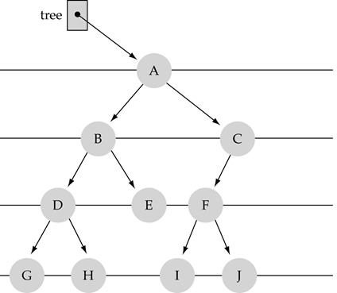
What is a binary tree?
Property 1: each node can have up to two successor nodes.

Slide 3
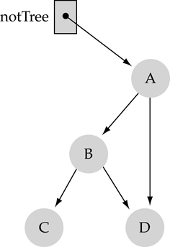
What is a binary tree? (cont.)
Property 2: a unique path exists from the root to every other node
Not a valid binary tree!

Slide 4
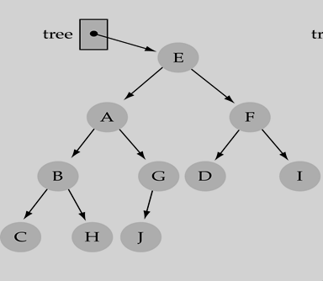
Some terminology
The successor nodes of a node are called its children
The predecessor node of a node is called its parent
The "beginning" node is called the root (has no parent)
A node without children is called a leaf

Slide 5
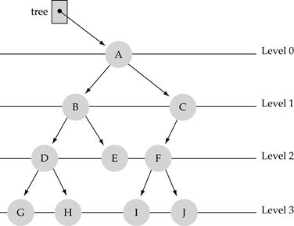
Some terminology (cont’d)
Nodes are organized in levels (indexed from 0).
Level (or depth) of a node: number of edges in the path from the root to that node.
Height of a tree h: #levels = L
(Warning: some books define h
as #levels-1).
Full tree: every node has exactly
two children and all the
leaves are on the same level.

Slide 6
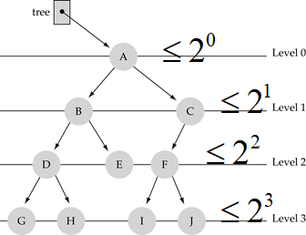
What is the max #nodes at some level l?
The max #nodes at level l is 2^{l} where l=0,1,2, L-1

Slide 7
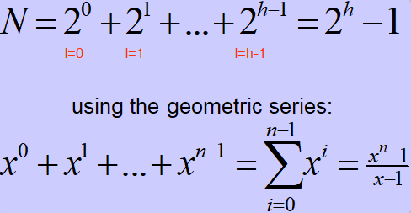
What is the total #nodes N of a full tree with height h?

Slide 8
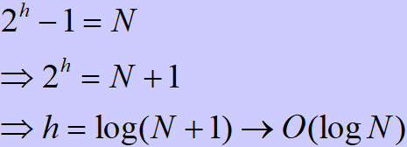
What is the height h of a full tree with N nodes?

Slide 9
Why is h important?
Tree operations (e.g., insert, delete, retrieve etc.) are typically expressed in terms of h.
So, h determines running time!

Slide 10
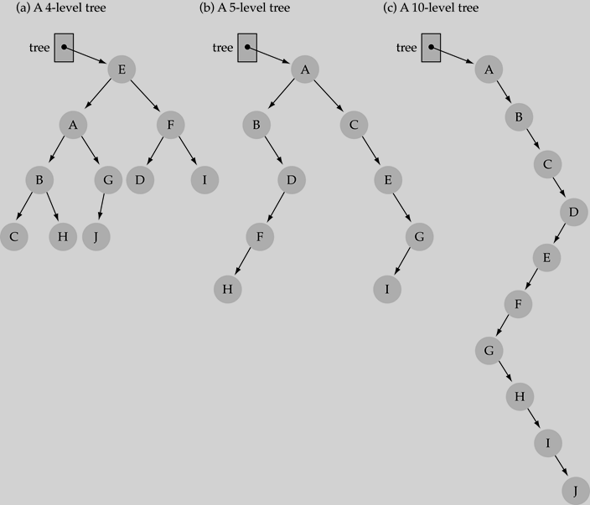

Slide 11
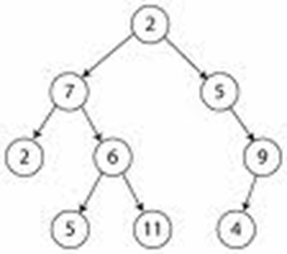

How to search a binary tree?
(1) Start at the root
(2) Search the tree level
by level, until you find
the element you are
searching for or you reach
a leaf.
Is this better than searching a linked list?

Slide 12
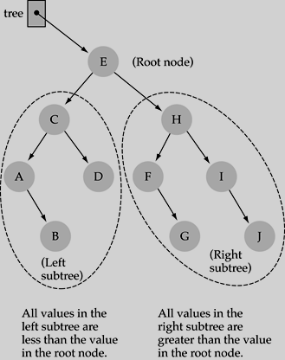
Binary Search Trees (BSTs)
Binary Search Tree Property:
The value stored at
a node is greater than
the value stored at its
left child and less than
the value stored at its
right child

Slide 13

Binary Search Trees (BSTs)
In a BST, the value stored at the root of a subtree is greater than any value in its left subtree and less than any value in its right subtree!

Slide 14
Binary Search Trees (BSTs)
Where is the smallest element?
Ans: leftmost element
Where is the largest element?
Ans: rightmost element

Slide 15

How to search a binary search tree?
(1) Start at the root
(2) Compare the value of the item you are searching for with the value stored at the root
(3) If the values are equal, then item found; otherwise, if it is a leaf node, then not found

Slide 16
How to search a binary search tree?
(4) If it is less than the value stored at the root, then search the left subtree
(5) If it is greater than the value stored at the root, then search the right subtree
(6) Repeat steps 2-6 for the root of the subtree chosen in the previous step 4 or 5

Slide 17
How to search a binary search tree?
How to search a binary search tree?
Yes !! ---> O(logN)

Slide 18
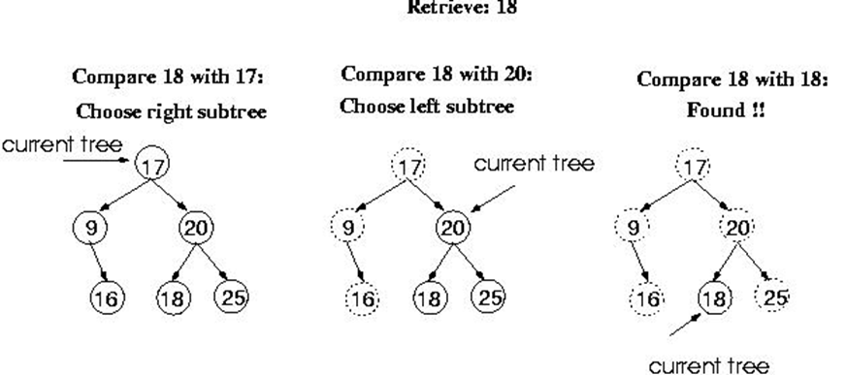
Function Retrieve Item

Slide 19
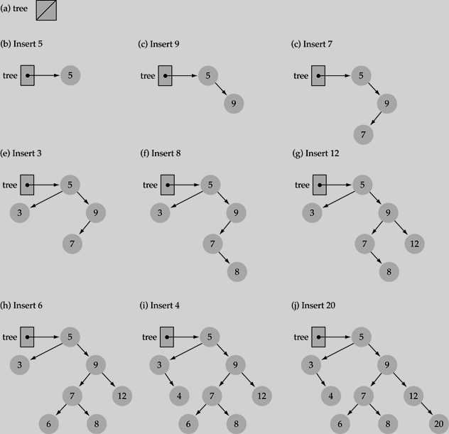
Function Insert Item
Use the binary search tree property to insert the new item at the correct place

Slide 20
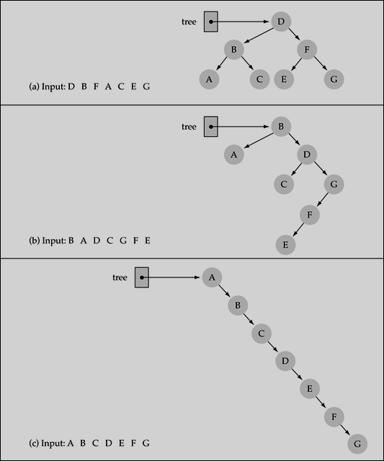
Does the order of inserting elements into a tree matter?
Yes, certain orders might produce very unbalanced trees!

Slide 21
Does the order of inserting elements into a tree matter? (cont’d)
Unbalanced trees are not desirable because search time increases!
Advanced tree structures, such as red-black trees, guarantee balanced trees.

Slide 22
Function Delete Item
First, find the item; then, delete it
Binary search tree property must be preserved!!
We need to consider three different cases:
(1) Deleting a leaf
(2) Deleting a node with only one child
(3) Deleting a node with two children

Slide 23
Deleting leaf node
Find the node in the given BST
Simply delete that Node.

Slide 24
Deleting a node with only one child
Find the node in the BST
Delete this node by connecting grandfather and grandchildren

Slide 25
If the node contains 2-children
Find the node in the given BST.
Delete that by replacing inorder successor or predecessor.

Slide 26
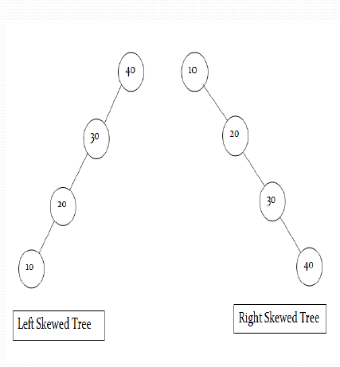
Skewed BST
If a tree which is dominated by left child node or right child node, is said to be a Skewed Binary Tree.
In a left skewed tree, most of the nodes have the left child without corresponding right child.
In a right skewed tree, most of the nodes have the right child without corresponding left child.

Slide 27
Limitation of BST
The average search time for a binary search tree is
directly proportional to its height: O(h). Most of the
operation average case time is O(log2n).
BST’s are not guaranteed to be balanced. It may be
skewed tree also.
For skewed BST, the average search time becomes
O(n). So, it is working like an linear array.
To improve average search time and make BST
balanced, AVL trees are used.

Slide 28
AVL Tree
AVL tree is a height balanced tree.
It is a self-balancing binary search tree.
It was invented by Adelson-Velskii and Landis.
AVL trees have a faster retrieval.
It takes O(logn) time for insertion and deletion
operation.
In AVL tree, difference between heights of left and
right subtree cannot be more than one for all
nodes.

Slide 29
AVL Tree
Balance Factor of node is:
Height of left subtree – Height of Right subtree
Balance Factor is calculated for every node of AVL
tree.
At every node, height of left and right subtree can
differ by no more than 1.
For AVL tree, the possible values of balance factor
are -1, 0, 1
Balance Factor of leaf nodes is 0 (zero).

Slide 30
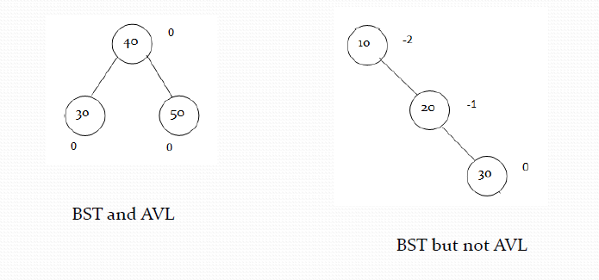
Example
Every AVL Tree is a binary search tree but all the
Binary Search Tree need not to be AVL trees.

Slide 31
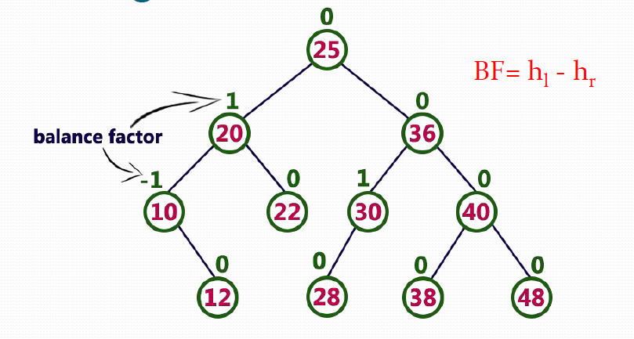
Finding Balance Factor

Slide 32
Height of AVL Tree
By the definition of complete trees, any complete
binary search tree is an AVL tree
Thus, an upper bound on the number of nodes in an
AVL tree of height h a perfect binary tree with 2^{h + 1} – 1 nodes.
What is a lower bound?

Slide 33
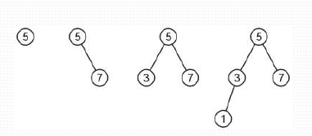
Height of AVL Tree
Let F(h) be the fewest number of nodes in a tree of
height h.
From a previous slide:
F(0) = 1
F(1) = 2
F(2) = 4
Then what is F(h) in general?

Slide 34
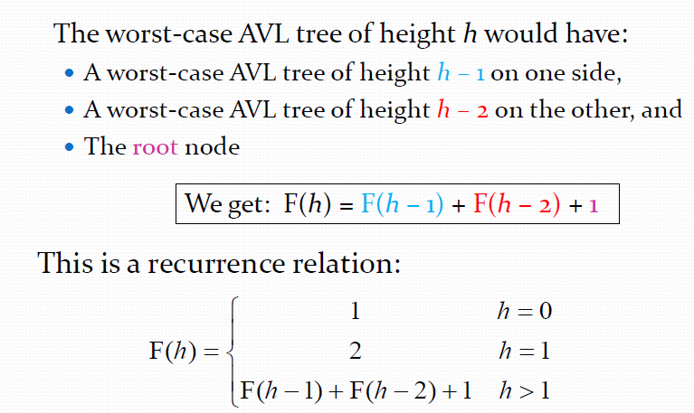
Height of AVL Tree

Slide 35
Imbalance
After an insertion, when the balance factor of node A
is –2 or 2, the node A is one of the following four
imbalance types
LL: new node is in the left subtree of the left subtree
of A
LR: new node is in the right subtree of the left
subtree of A
RR: new node is in the right subtree of the right
subtree of A
RL: new node is in the left subtree of the right
subtree of A

Slide 36
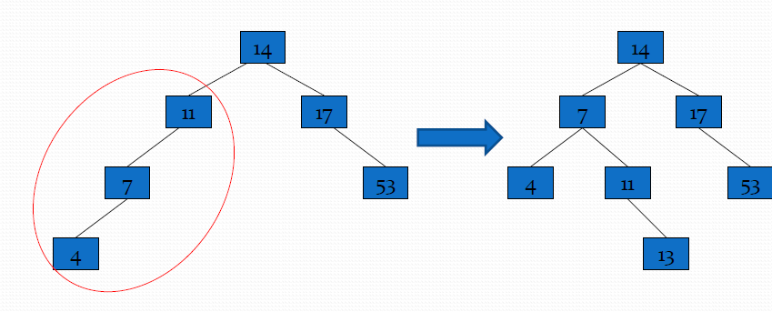
AVL Tree Example
Insert 14, 17, 11, 7, 53, 4, 13 into an empty AVL tree

Slide 37
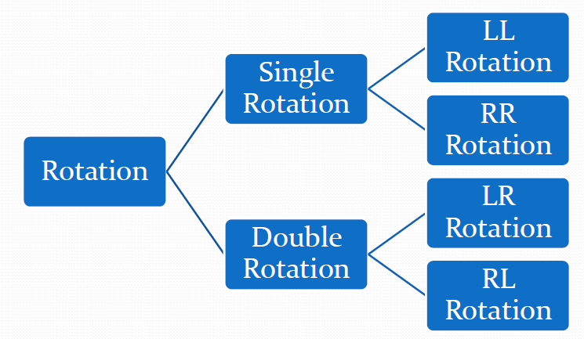
Types of Rotation
Rotation- To switch children and parents among two or
three adjacent nodes to restore balance of a tree.

